Slide 1
Prototype screen designs
Mrataxes App
By kings Mkumbwa

Slide 2
Ui design.
logo
Navigation menu
User logged in/ logout
content

Slide 3
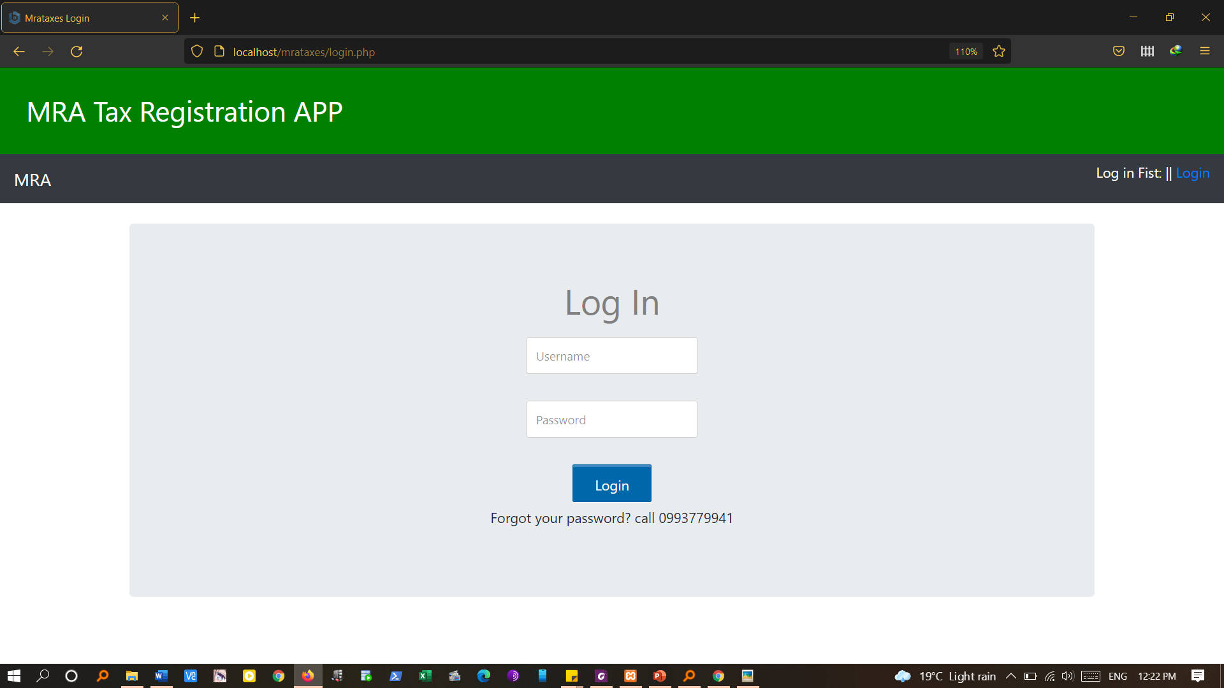
Login page

Slide 4
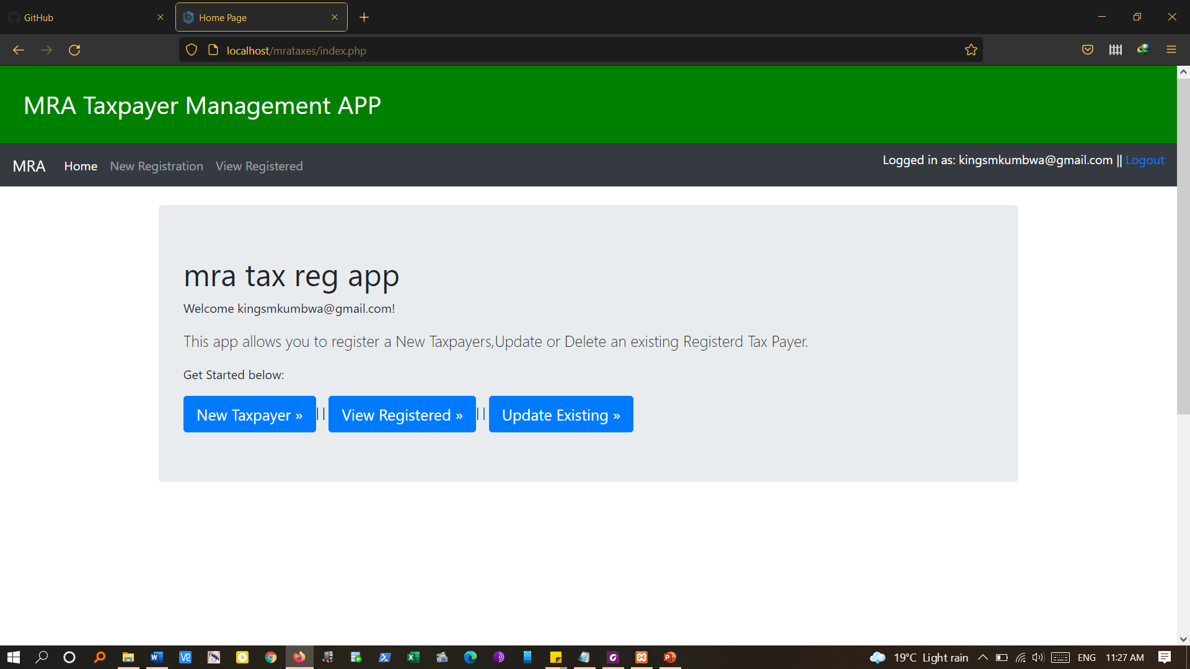
Home/dashboard

Slide 5
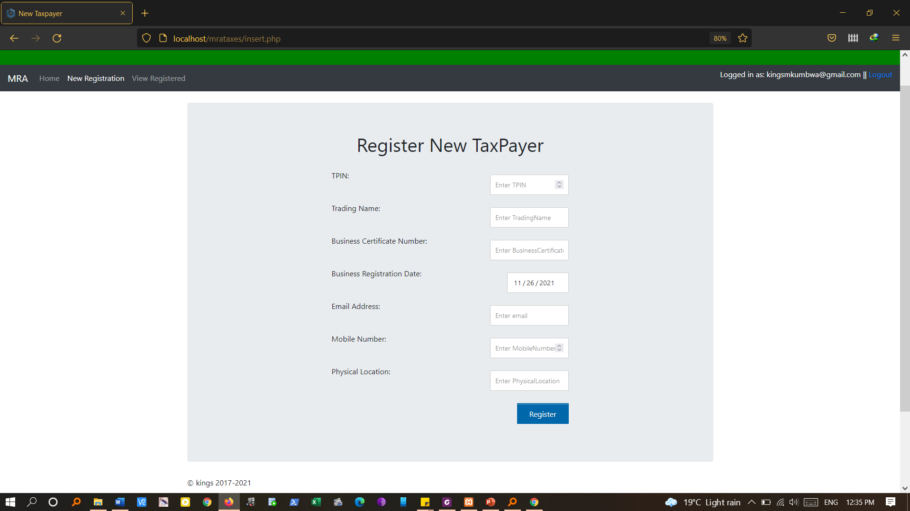
Add tax payers

Slide 6
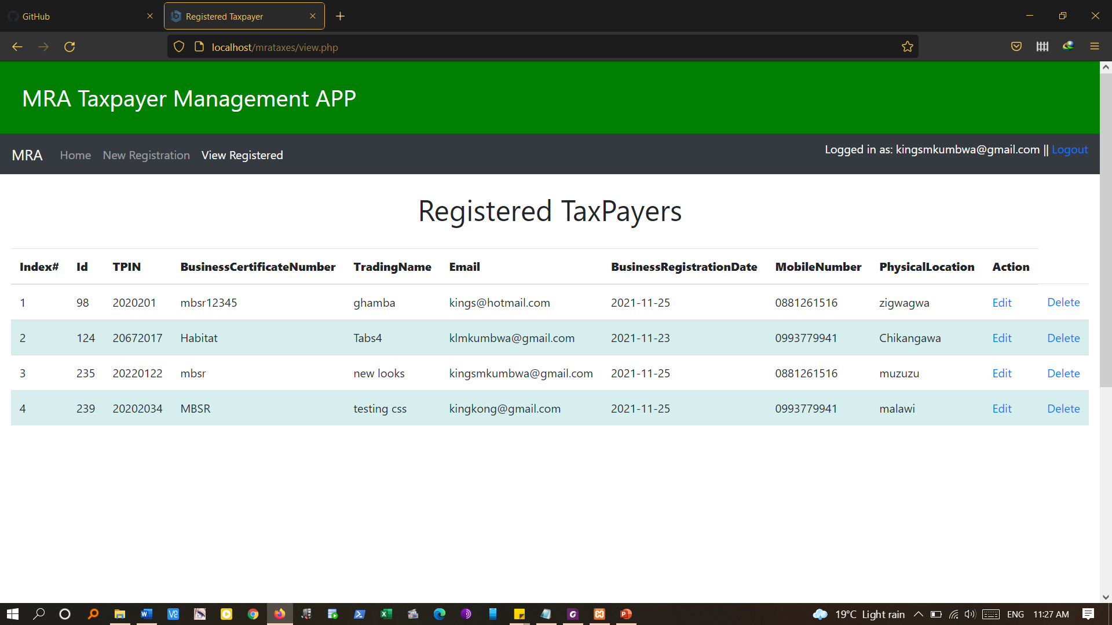
View tax payers, edit , delete

Slide 7
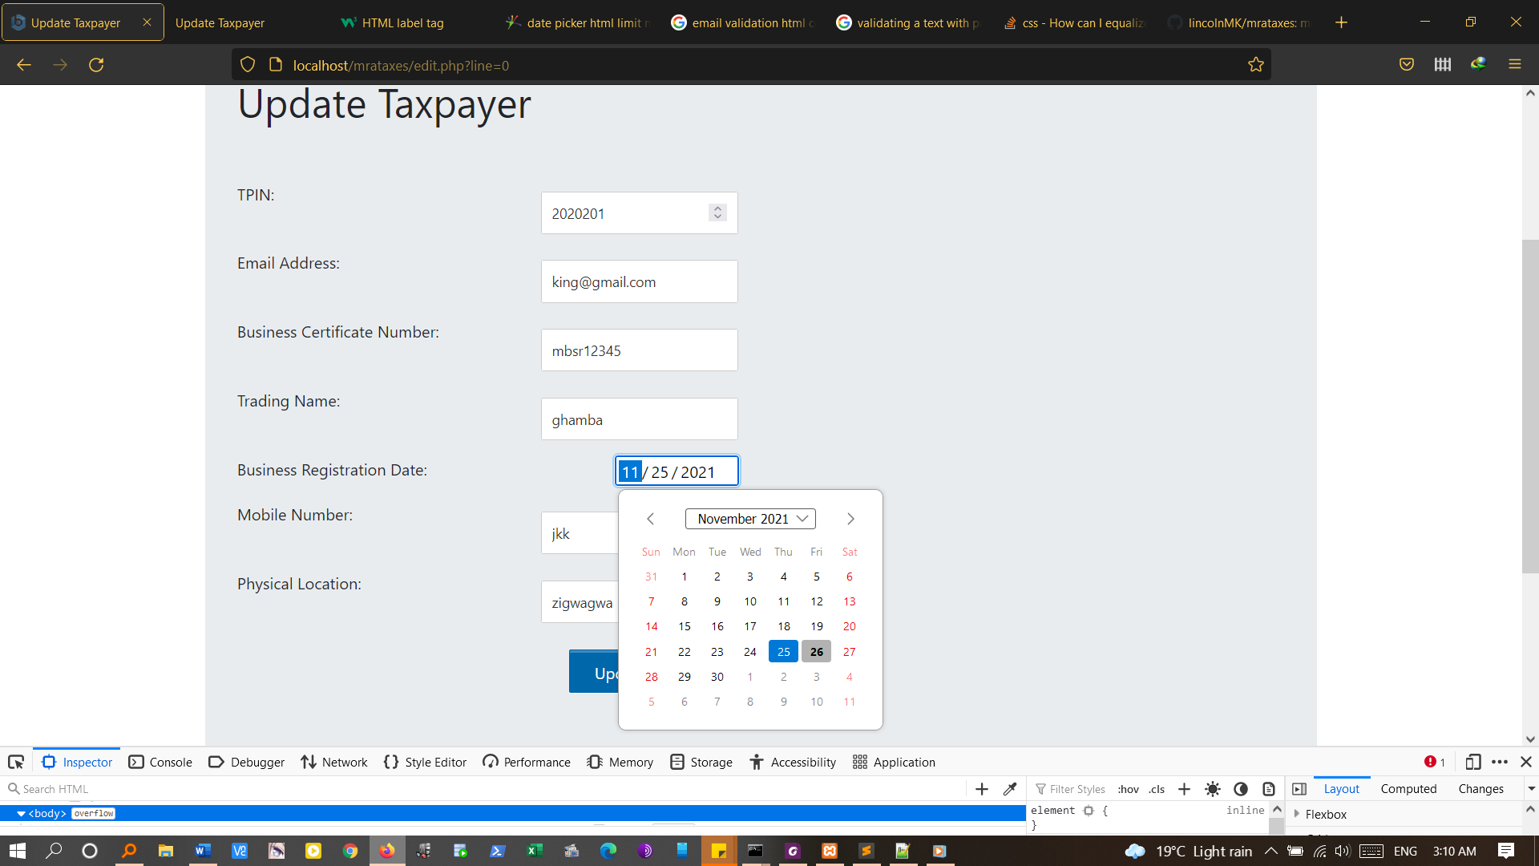
Update tax payers

Slide 8
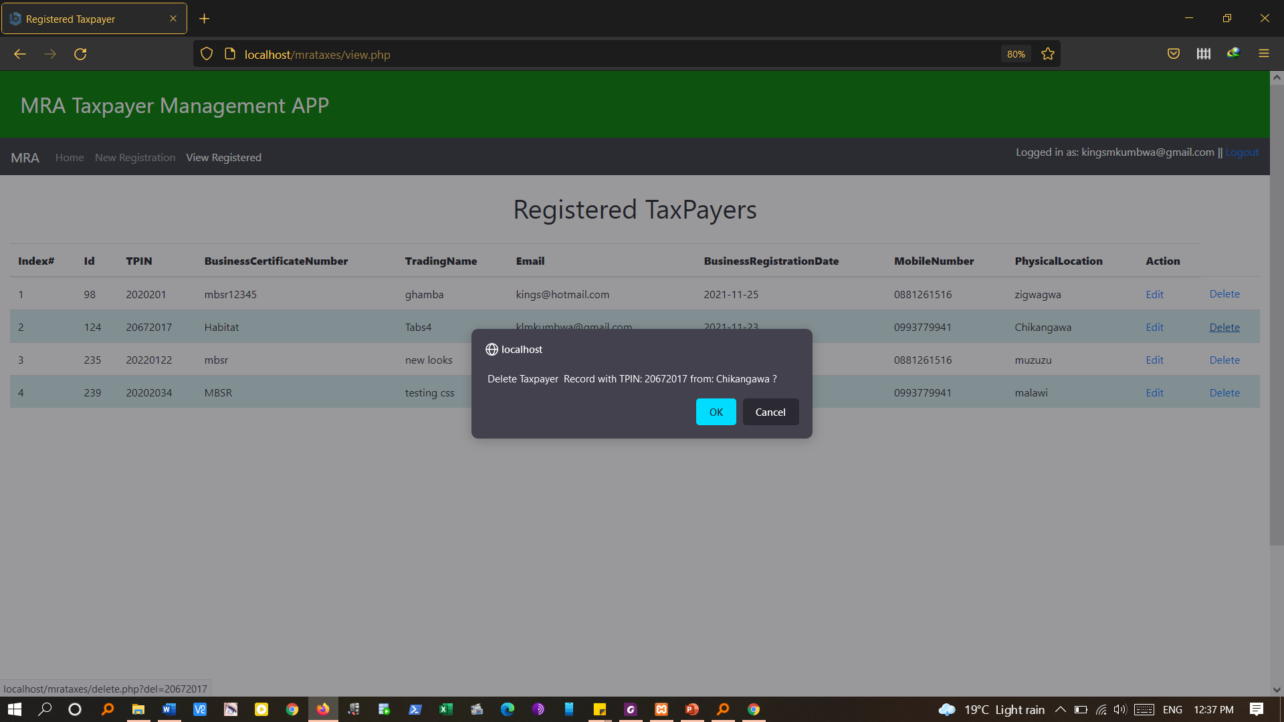
Delete

Slide 9
logout

